Slide 1


Automation Testing Approaches
Valentyn Kvasov
MARCH 25, 2016

Slide 2
Agenda
TDD
BDD
DDT
KTD

Slide 3

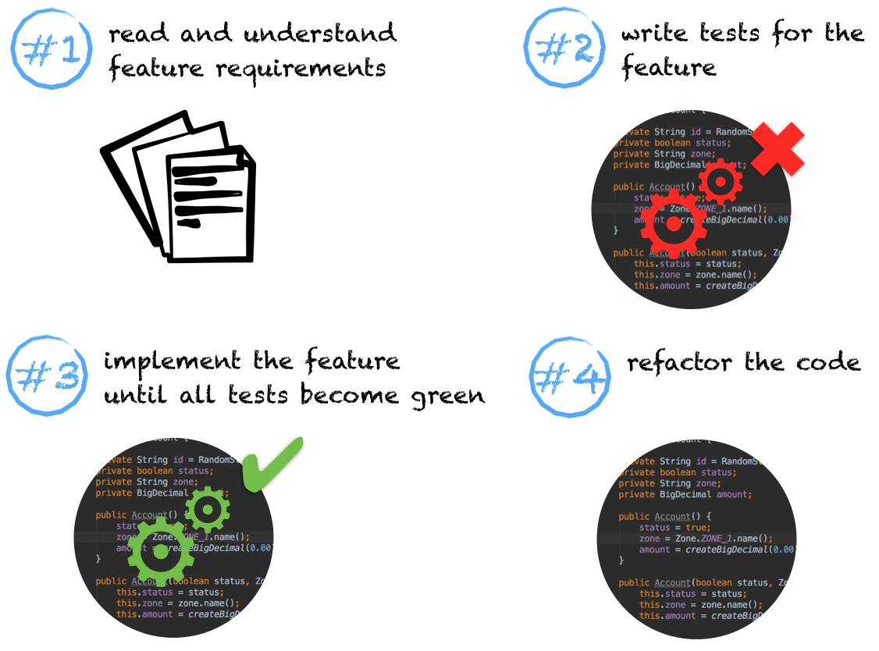

TDD
Test-driven development is an evolutionary approach to development which combines
test-first development where you write a test before you write just enough production
code to fulfill that test and refactoring.

Slide 4
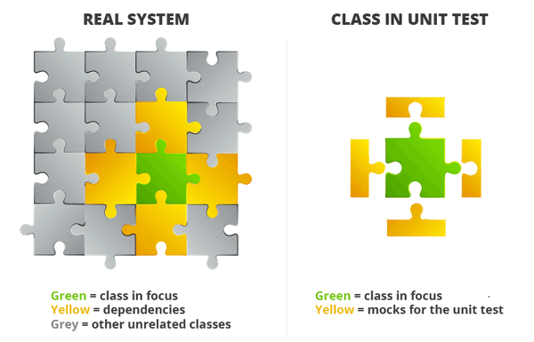
Mock-object
Dummy - empty objects, which are transmitted inside of caused inner methods but they are not used. They are designed only for filling method options
Fake - objects which have working implementations but they are inappropriate for using them in production code. (For example, in-memory database)
Stubs - objects which provide previously prepared answer for requests when test is in process. They usually don't respond for requests which are not required in test. They can also memorize extra info about amount of calls, options and send it back for test.
Mocks - objects which can replace real object in test condition and give opportunity to check calls of their parts of system or unit-test. They have previously programmed expectations for calls which they expect to receive. Mock objects are used mostly in interaction (behavioral) testing.
http://www.martinfowler.com/bliki/InMemoryTestDatabase.html

Slide 5
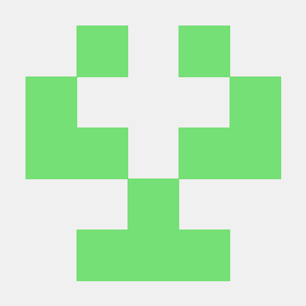
PODAM – (POjo DAta Mocker)
class Country { String capital; Currency currency; List<City> cities; enum Currency { DOLLAR, EURO } }
@Test public void simpleTestMethod(){ PodamFactory factory = new PodamFactoryImpl(); Country country = factory.manufacturePojo(Country.class);
System.out.println(ReflectionToStringBuilder.toString(country)); }
class City { List<Person> persons; String name; }
class Person { String name; String secondName; byte age; Gender gender; enum Gender { MALE, FEMALE } }
<dependency>
<groupId>uk.co.jemos.podam</groupId>
<artifactId>podam</artifactId>
<version>6.0.2.RELEASE</version>
</dependency>
http://home.btconnect.com/jemosagile//projects/podam/index.html

Slide 6

Mockito
Mockito is a mocking framework that tastes really good. It lets you write beautiful tests with a clean & simple API. Mockito doesn’t give you hangover because the tests are very readable and they produce clean verification errors. Read more about features & motivations.
<dependency>
<groupId>org.mockito</groupId>
<artifactId>mockito-all</artifactId>
<version>1.10.19</version>
</dependency>
http://mockito.org/

Slide 7

PowerMock
PowerMock is a framework that extends other mock libraries such as EasyMock and Mockito with more powerful capabilities. PowerMock uses a custom classloader and bytecode manipulation to enable mocking of static methods, constructors, final classes and methods, private methods, removal of static initializers and more.
<dependency>
<groupId>org.powermock</groupId>
<artifactId>powermock-core</artifactId>
<version>1.6.4</version>
</dependency>
https://github.com/jayway/powermock

Slide 8
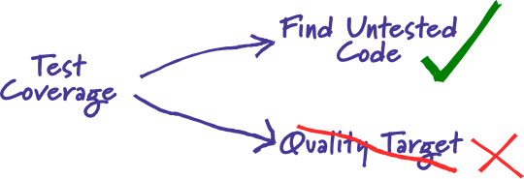
Code Coverage
Code coverage is a measure used to describe the degree to which the source code of a program is tested by a particular test suite
Java Code Coverage Tools
JCov
JaCoCo
Clover
Cobertura
EMMA
Serenity
http://martinfowler.com/bliki/TestCoverage.html

Slide 9

JaCoCo
JaCoCo should provide the standard technology for code coverage analysis in Java VM based environments. The focus is providing a lightweight, flexible and well documented library for integration with various build and development tools.
http://eclemma.org/jacoco
https://github.com/pkainulainen/maven-examples/tree/master/code-coverage-jacoco

Slide 10
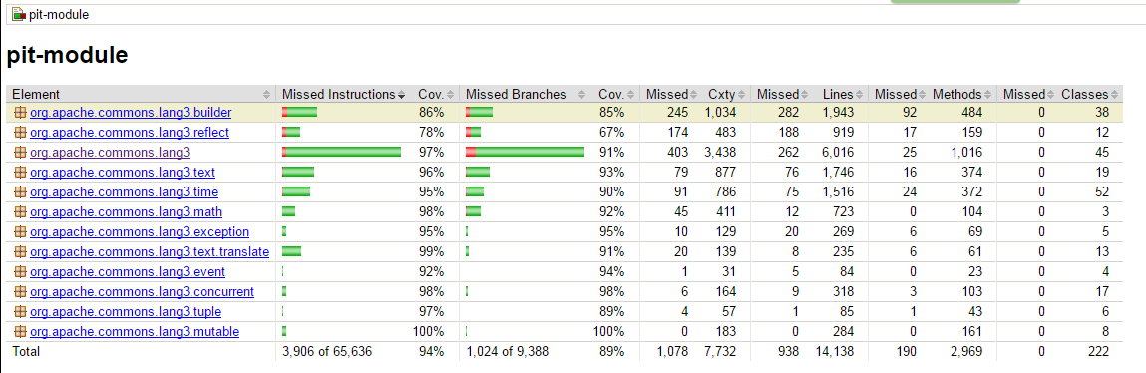

Slide 11

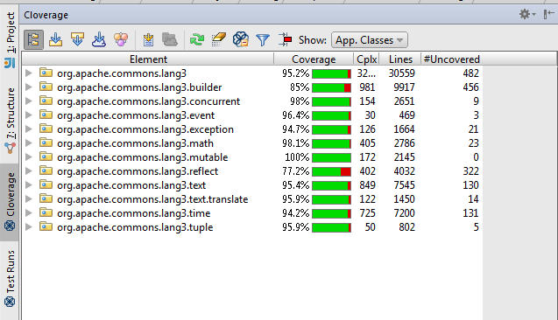
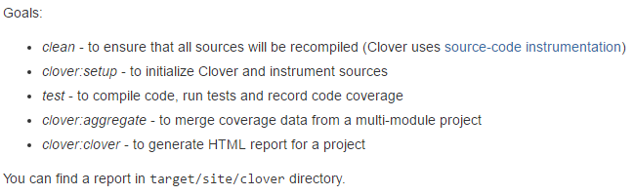
Clover
Clover is a Java Code Coverage Analysis application bought and further developed by Atlassian. It is a commercial product freely available to open source projects and non-profit institutions.
<settings ...>
<pluginGroups>
<pluginGroup>com.atlassian.maven.plugins</pluginGroup>
</pluginGroups>
</settings>
mvn clean clover:setup test clover:aggregate clover:clover
https://www.atlassian.com/software/clover/overview

Slide 12
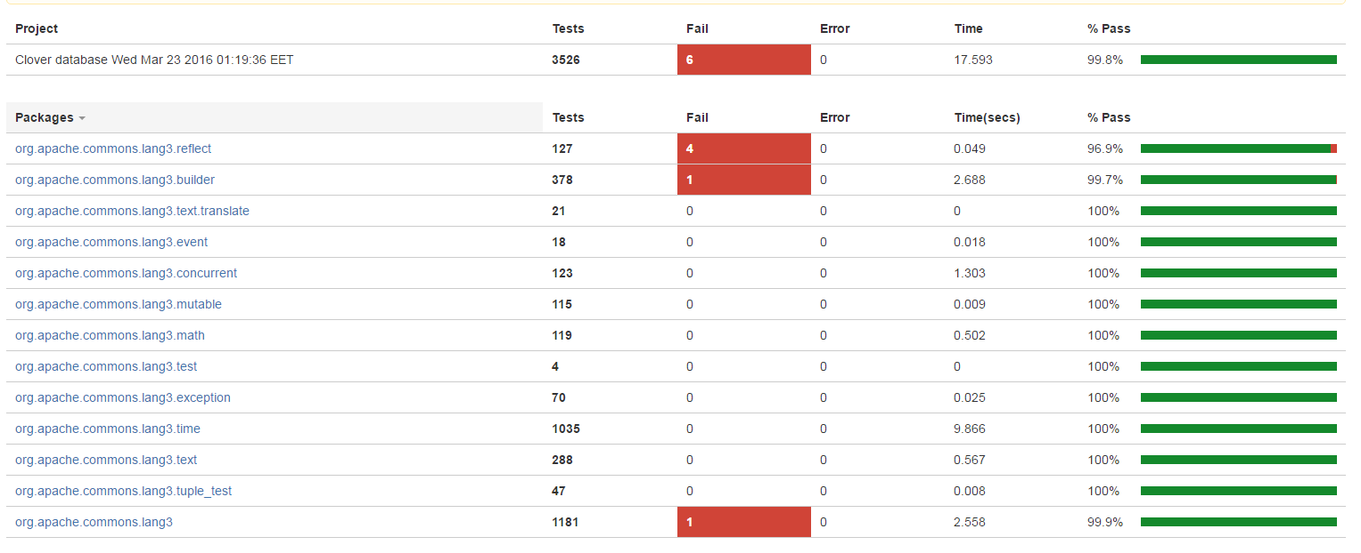

Slide 13
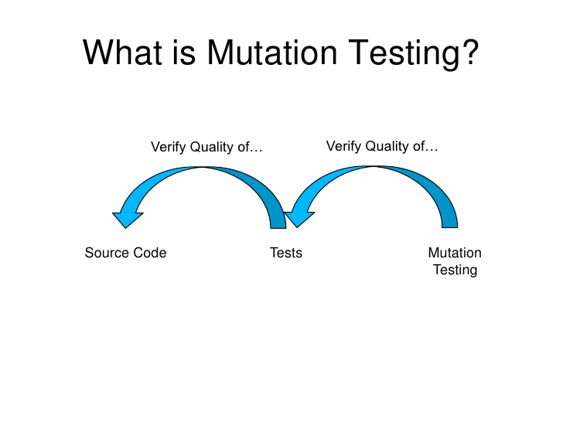
Mutations testing (Mutation analysis or Program mutation)
Mutation testing is a method of software testing in which program or source code is deliberately manipulated, followed by suite of testing against the mutated code. The mutations introduced to source code are designed to imitate common programming errors. A good unit test suite typically detects the program mutations and fails automatically.

Slide 14
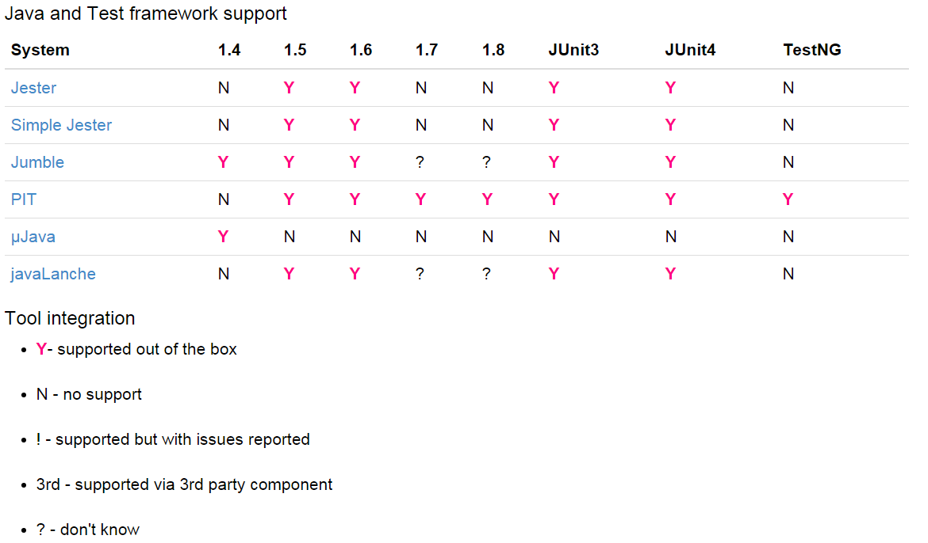

Slide 15
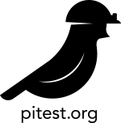
Pitest
<plugin> <groupId>org.pitest</groupId> <artifactId>pitest-maven</artifactId> <version>1.1.9</version> <configuration> <targetClasses> <param>com.your.package.root.want.to.mutate*</param> </targetClasses> <targetTests> <param>com.your.package.root*</param> </targetTests> </configuration> </plugin>
mvn org.pitest:pitest-maven:mutationCoverage
mvn org.pitest:pitest-maven:mutationCoverage –Dpit.threads=3
<mutators> <mutator>CONDITIONALS_BOUNDARY</mutator> // <, <=, >, >= <mutator>NEGATE_CONDITIONALS</mutator> //!= <mutator>MATH</mutator> //-+ <mutator>INCREMENTS</mutator> <mutator>INVERT_NEGS</mutator> //-
<mutator>INLINE_CONSTS</mutator> <mutator>RETURN_VALS</mutator>
<mutator>CONSTRUCTOR_CALLS</mutator> <mutator>VOID_METHOD_CALLS</mutator> </mutators>
http://pitest.org

Slide 16
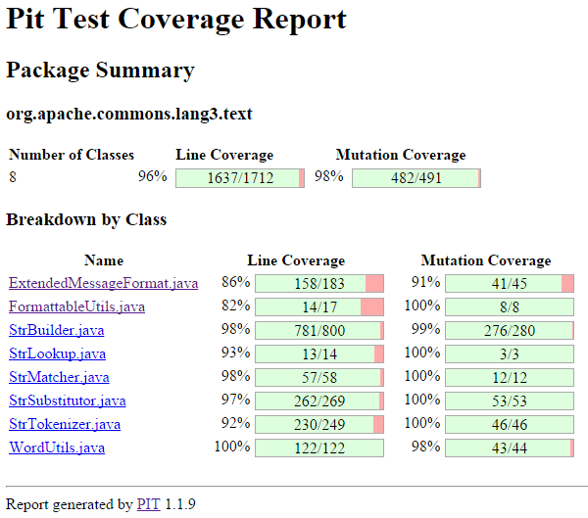

Slide 17

BDD
Behavior-driven development (BDD) is an agile software development method which is based on agile values and principles. BDD, established by Dan North in 2006, was a response to the pitfalls of test-driven development (TDD) with the aim of delivering software that matters. So, behavior-driven development is implementing an application – or parts of it – by describing its behavior from the perspective of its stakeholders.
http://dannorth.net/introducing-bdd/

Slide 18
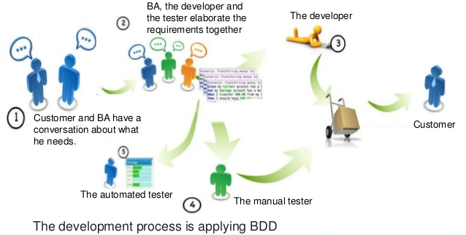

Slide 19
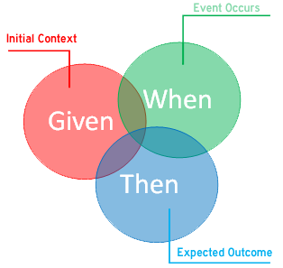
Gherkin syntax
Feature: Refund item
Scenario: Jeff returns a faulty microwave
Given Jeff has bought a microwave for $100
And he has a receipt
When he returns the microwave
Then Jeff should be refunded $100
Arrange-Act-Assert - a pattern for arranging and formatting code in UnitTest methods:
Given - arrange When - act Then - assert

Slide 20

Cucumber is a software tool that computer programmers use for testing other software. It runs automated acceptance tests written in a behavior-driven development (BDD) style. Cucumber is written in the Ruby programming language.
<dependency>
<groupId>info.cukes</groupId>
<artifactId>cucumber-java8</artifactId>
<version>1.2.3</version>
<scope>test</scope>
</dependency>
<dependency>
<groupId>info.cukes</groupId>
<artifactId>cucumber-java</artifactId>
<version>1.2.3</version>
<scope>test</scope>
</dependency>
https://cucumber.io/

Slide 21

JBehave is a framework for Behaviour-Driven Development (BDD). BDD is an evolution of test-driven development (TDD) and acceptance-test driven design, and is intended to make these practices more accessible and intuitive to newcomers and experts alike. It shifts the vocabulary from being test-based to behaviour-based, and positions itself as a design philosophy.
<dependency>
<groupId>org.jbehave</groupId>
<artifactId>jbehave-core</artifactId>
<version>4.0.5</version>
</dependency>
http://jbehave.org/

Slide 22

Concordion is an open source framework for Java that lets you turn a plain English description of a requirement into an automated test.
<dependency>
<groupId>org.concordion</groupId>
<artifactId>concordion</artifactId>
<version>1.5.1</version>
</dependency>
http://concordion.org/

Slide 23
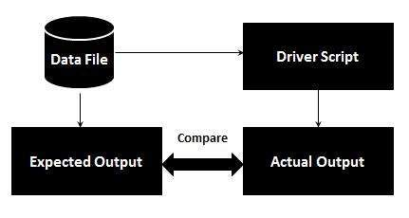
DDT
Data-driven testing is creation of test scripts where test data and/or output values are read from data files instead of using the same hard-coded values each time the test runs. This way, testers can test how the application handles various inputs effectively. It can be any of the below data files.

Slide 24

EasyTest is a JUnit extension perform Data Driven Testing with ease and simplicity. It supports method parameters with Test annotation and much more.
<dependency>
<groupId>org.easetech</groupId>
<artifactId>easytest-core</artifactId>
<version>1.4.0</version>
</dependency>
https://github.com/EaseTech/easytest/wiki

Slide 25
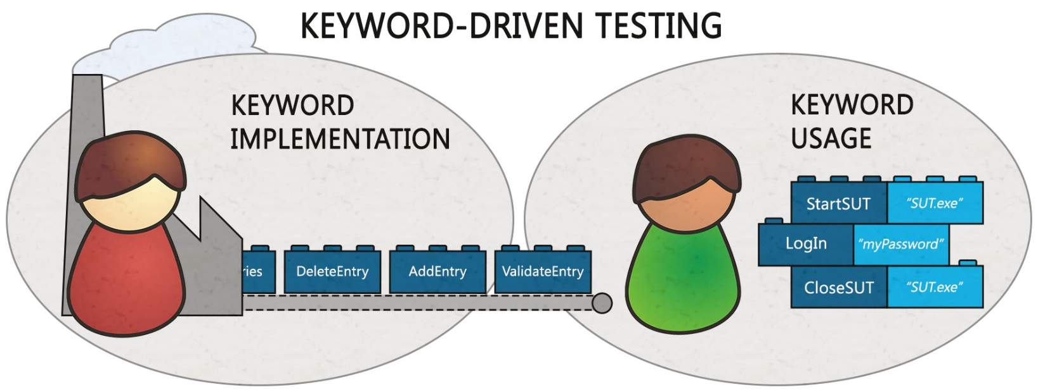
KDT
Keyword-driven testing (table-driven testing) is a type of functional automation testing framework which is also known as table-driven testing or action word based testing. In Keyword-driven testing, we use a table format, usually a spreadsheet, to define keywords or action words for each function that we would like to execute.

Slide 26
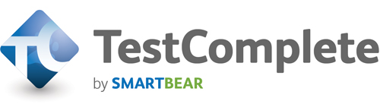
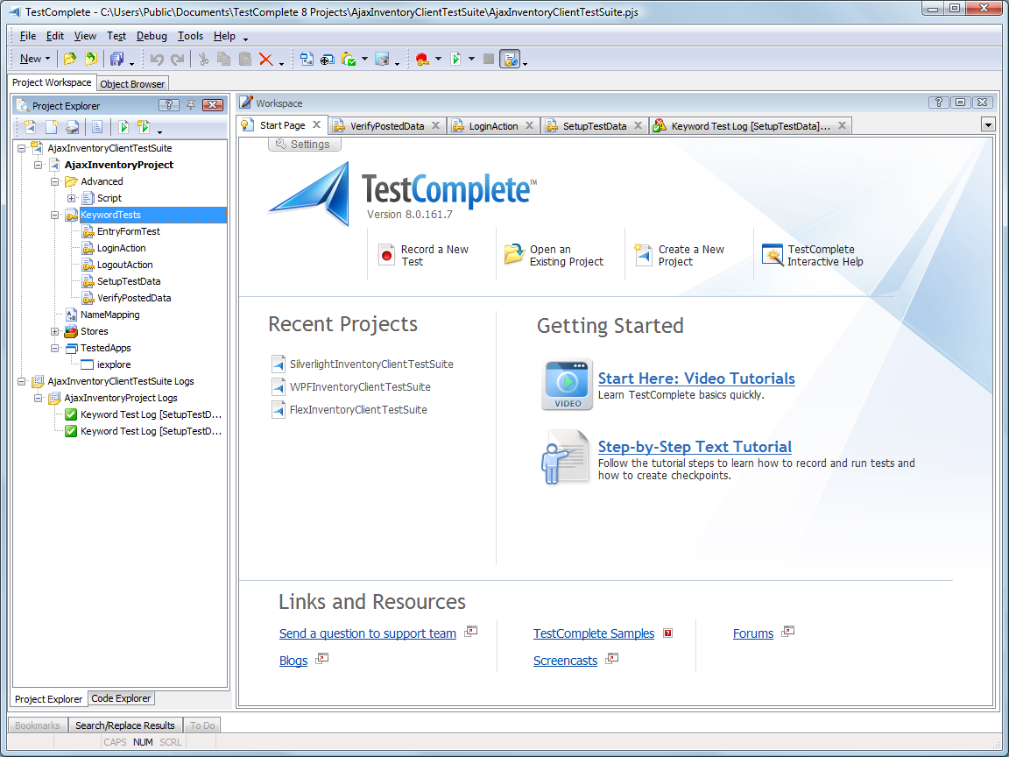
TestComplete is a functional automated testing platform developed by SmartBear Software. TestComplete gives testers the ability to create automated tests for Microsoft Windows, Web, Android (operating system), and iOS applications. Tests can be recorded, scripted or manually created with keyword driven operations and used for automated playback and error logging.
https://smartbear.com/product/testcomplete/overview/

Slide 27

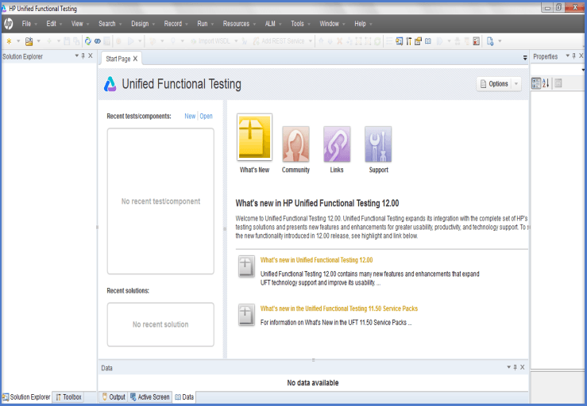
HP QuickTest Professional (QTP), an automated functional testing tool that helps testers to perform automated regression testing in order to identify any gaps, errors/defects in contrary to the actual/desired results of the application under test.
Buy the QTP license at $7,500 per seat, plus $1,500 per seat per year in maintenance. We hear rumors of the Ajax protocol handler for QTP costs an extra $12,000. That will get you functional testing for Web 1.0 applications.
http://www8.hp.com/us/en/software-solutions/unified-functional-automated-testing/index.html

Slide 28

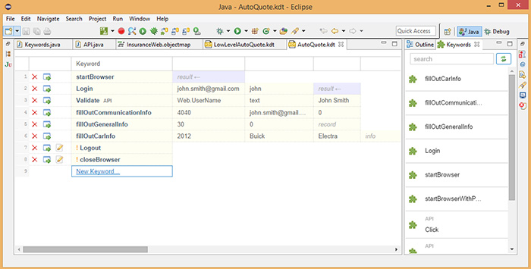
SilkTest is a tool for automated function and regression testing of enterprise applications.
http://www.borland.com/en-GB/Products/Software-Testing/Automated-Testing/Silk-Test

Slide 29
Thanks! Questions?

